Slide 1

BNV : Implementing Arbitrary Topologies through
Bare-metal Network Virtualization

Slide 2



Tenant 1
Tenant 2
Tenant 3
Tenant n
FatTree, JellyFish, HyperCube, HyperX, Xpander, Arbitrary topologies…etc
OpenDaylight Controller
ONOS Controller
POX Controller
Any SDN Controller
…
Virtual Topology
BNV
Topology Abstraction
BNV Mapper
Tenant Mapping
Flow Translation
OpenFlow
Switch1
Switch2
Switch3

Slide 3
Tenant 1
Tenant 2
Tenant 3
Tenant n
FatTree, JellyFish, HyperCube, HyperX, Xpander, Arbitrary topologies…etc
OpenDaylight Controller
ONOS Controller
POX Controller
Any SDN Controller
…
Virtual Topology
BNV
Topology Abstraction
BNV Mapper
Tenant Mapping
Flow Translation
OpenFlow
Switch1
Switch2
Switch3

Slide 4
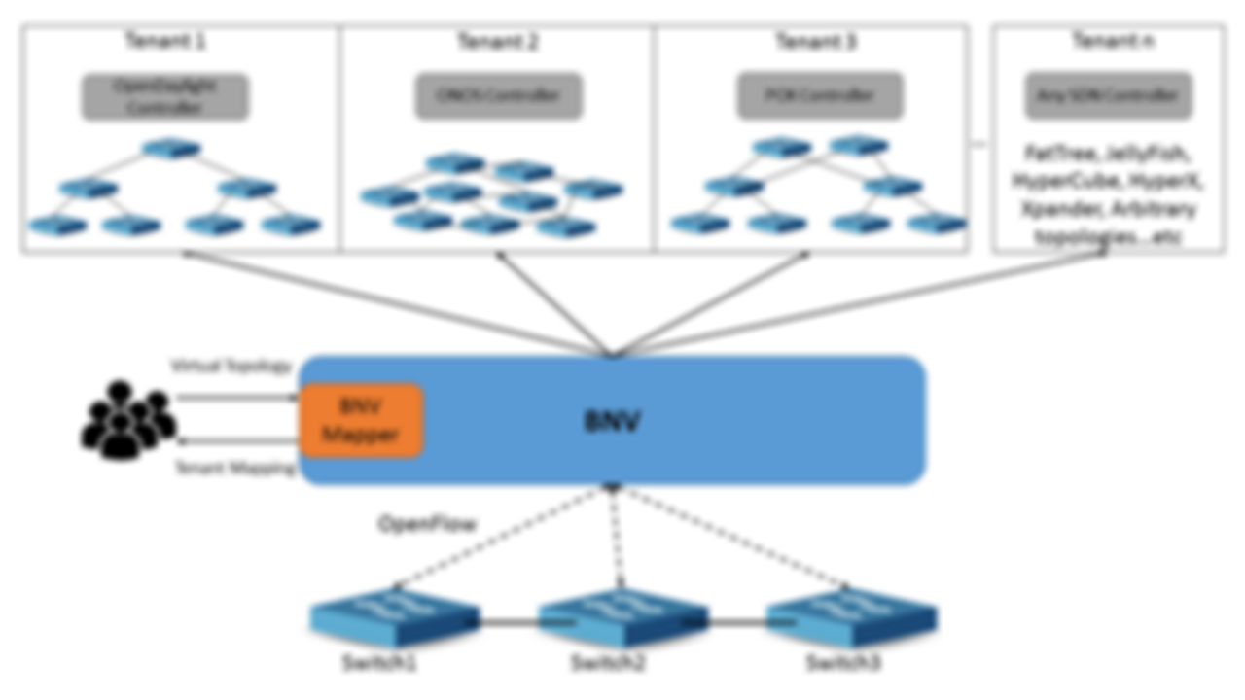

Topology Abstraction
Flow Translation

Slide 5
GENERIC Topology
pSwitch1
CLink1
pSwitch2
5
5
1
2
3
4
1
2
3
4
H1
H2
H3
H4
H5
H6
H7
H8

Slide 6
vS1
vL1
vS3
H1
1
3
2
1
H5
2
1G
3
1G
1G
vL3
vS2
vL2
2
1
3
H2
Virtual Topology
Physical Topology
pSwitch1
CLink1
pSwitch2
5
10G
5
1
2
3
4
1
2
3
4
H1
H2
H3
H4
H5
H6
H7
H8

Slide 7
vS1
vL1
vS3
H1
1
3
2
1
H5
2
1G
3
1G
1G
vL2
vS2
vL2
2
1
3
H2
Virtual Topology
Physical Topology
pSwitch1
CLink1
pSwitch2
5
10G
5
1
2
3
4
1
2
3
4
H1
H2
H3
H4
H5
H6
H7
H8

Slide 8
vS1
vL1 -> CLink1
vS3
H1
1
3
2
1
H5
2
1G
3
1G
1G
vL3
vS2
vL2
2
1
3
H2
Virtual Topology
Physical Topology
pSwitch1
CLink1
pSwitch2
5
10G
5
1
2
3
4
1
2
3
4
H1
H2
H3
H4
H5
H6
H7
H8

Slide 9
vS1
vL1 -> CLink1
vS3
H1
1
3
2
1
H5
2
1G
3
1G
1G
vL3
vS2
vL2
2
1
3
H2
Virtual Topology
Physical Topology
pSwitch1
CLink1
pSwitch2
5
10G
5
1
2
3
4
1
2
3
4
H1
H2
H3
H4
H5
H6
H7
H8

Slide 10
vS1
vL1 -> CLink1
vS3
H1
1
3
2
1
H5
2
1G
3
1G
1G
vL3
vS2
vL2 -> CLink1
2
1
3
H2
Virtual Topology
Physical Topology
pSwitch1
CLink1
pSwitch2
5
5
1
2
3
4
10G
1
2
3
4
H1
H2
H3
H4
H5
H6
H7
H8

Slide 11
Final Mapping
vS1
vL1 -> CLink1
vS3
H1
1
3
2
1
H5
2
1G
3
1G
1G
vL3 -> Bounce Link
vS2
vL2 -> CLink1
2
1
3
H2
Virtual Topology
Physical Topology
pSwitch1
CLink1
pSwitch2
5
5
1
2
3
4
10G
1
2
3
4
H1
H2
H3
H4
H5
H6
H7
H8

Slide 12
Link 1 using Packet Tagging
PKT
H1
vS1
vL1 : Tag 1
vS3
H5
1
2
3
2
1
3
Tag 3
Tag 2
vS2
2
1
3
H2
Virtual Topology
Physical Topology
pSwitch1
PKT
1
PKT
pSwitch2
5
CLink1
5
1
2
3
4
1
2
3
4
PKT
H1
H2
H3
H4
H5
H6
H7
H8

Slide 13
Link 2
H1
vS1
vL1: Tag 1
vS3
H5
1
2
3
2
1
3
PKT
Tag 3
vL2: Tag 2
vS2
2
1
3
H2
Virtual Topology
Physical Topology
pSwitch1
PKT
CLink1
PKT
2
pSwitch2
5
5
1
2
3
4
1
2
3
4
H1
H2
H3
H4
PKT
H5
H6
H7
H8

Slide 14
Link3 :
Bounce back Link
H1
vS1
vL1: Tag 1
vS3
H5
1
2
3
2
1
3
vL3: Tag 3
vL2: Tag 2
vS2
2
1
3
H2
Virtual Topology
PKT
Physical Topology
Overhead = 100%
PKT
3
pSwitch1
PKT
CLink1
pSwitch2
5
5
1
2
3
4
1
2
3
4
H1
H2
H3
H4
H5
H6
H7
H8
PKT

Slide 15

Y
Core Network
Capacity L
Capacity L
NL/2
H Ports
H Ports
……
NL/4
N Switches
X
NH
Always
Feasible
Feasibility depends on topology
X: Number of Hosts Y: Number of inter-switch links

Slide 16
Can we do better?

Slide 17
Idea : Loopback links in substrate topology

Slide 18
Idea : Loopback links in substrate topology

Slide 19
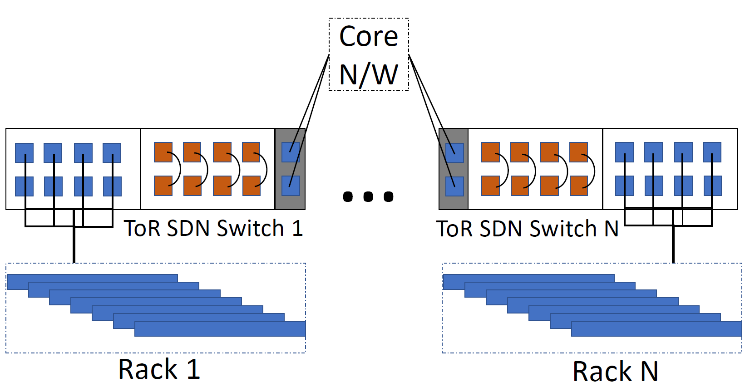
Idea : Loopback links in substrate topology

Slide 20
Topology + Loopback link
pSwitch1
CLink1
pSwitch2
5
5
1
2
3
4
1
2
3
4
H1
H2
LoopLink1
H5
H6
LoopLink2

Slide 21
H1
vS1
vL1 -> CLink1
vS3
H5
1
2
3
2
1
3
vS2
2
1
3
H2
Virtual Topology
Physical Topology
pSwitch1
CLink1
pSwitch2
5
5
1
2
3
4
1
2
3
4
H1
H2
LoopLink1
H5
H6
LoopLink2

Slide 22
H1
vS1
vL1 -> CLink1
vS3
H5
1
2
3
2
1
3
vL2 -> CLink1
vS2
2
1
3
H2
Virtual Topology
Physical Topology
pSwitch1
5
CLink1
pSwitch2
5
1
2
3
4
1
2
3
4
H1
H2
LoopLink1
H5
H6
LoopLink2

Slide 23
H1
vS1
vL1 -> CLink1
vS3
H5
1
2
3
2
1
3
vL3 -> LoopLink1
vL2 -> CLink1
vS2
2
1
3
H2
Virtual Topology
Physical Topology
pSwitch1
5
CLink1
pSwitch2
5
1
2
3
4
1
2
3
4
H1
H2
LoopLink1
H5
H6
LoopLink2

Slide 24
Link3 :
Loop Link
H1
vS1
VL1 : Tag 1
vS3
H5
1
2
3
2
1
3
vL3: Tag 3
vL2: Tag 2
No Traffic Overhead in Core Link.
vS2
2) Consistency & Fidelity of mapping.
2
3
3) Complete traffic isolation.
1
H2
Virtual Topology
PKT
Physical Topology
pSwitch1
CLink1
pSwitch2
5
5
1
2
3
4
1
2
3
4
H1
H2
LoopLink1
H5
H6
LoopLink2
PKT

Slide 25
Y
NL/2+NH/2
Core Network
NL/4+NH/2
Capacity L
Capacity L
NL/2
H Ports
H Ports
……
NL/4
N Switches
X
Always
Feasible
Feasibility depends on topology
X: Number of Hosts Y: Number of inter-switch links

Slide 26
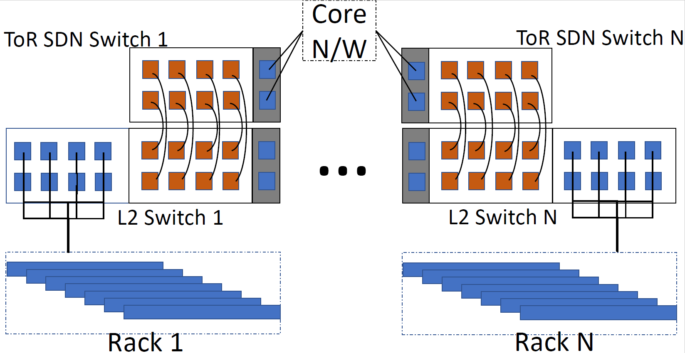
Software-Configurable Loopbacks

Slide 27
Tenant 1
Tenant 2
Tenant 3
Tenant n
FatTree, JellyFish, HyperCube, HyperX, Xpander, Arbitrary topologies…etc
OpenDaylight Controller
ONOS Controller
POX Controller
Any SDN Controller
…
Virtual Topology
BNV
Topology Abstraction
BNV Mapper
Tenant Mapping
Flow Translation
OpenFlow
Switch1
Switch2
Switch3

Slide 28
Tenant 1
Tenant 2
Tenant 3
Tenant n
FatTree, JellyFish, HyperCube, HyperX, Xpander, Arbitrary topologies…etc
OpenDaylight Controller
ONOS Controller
POX Controller
Any SDN Controller
…
Virtual Topology
BNV
Topology Abstraction
BNV Mapper
Tenant Mapping
Flow Translation
OpenFlow
Switch1
Switch2
Switch3

Slide 29
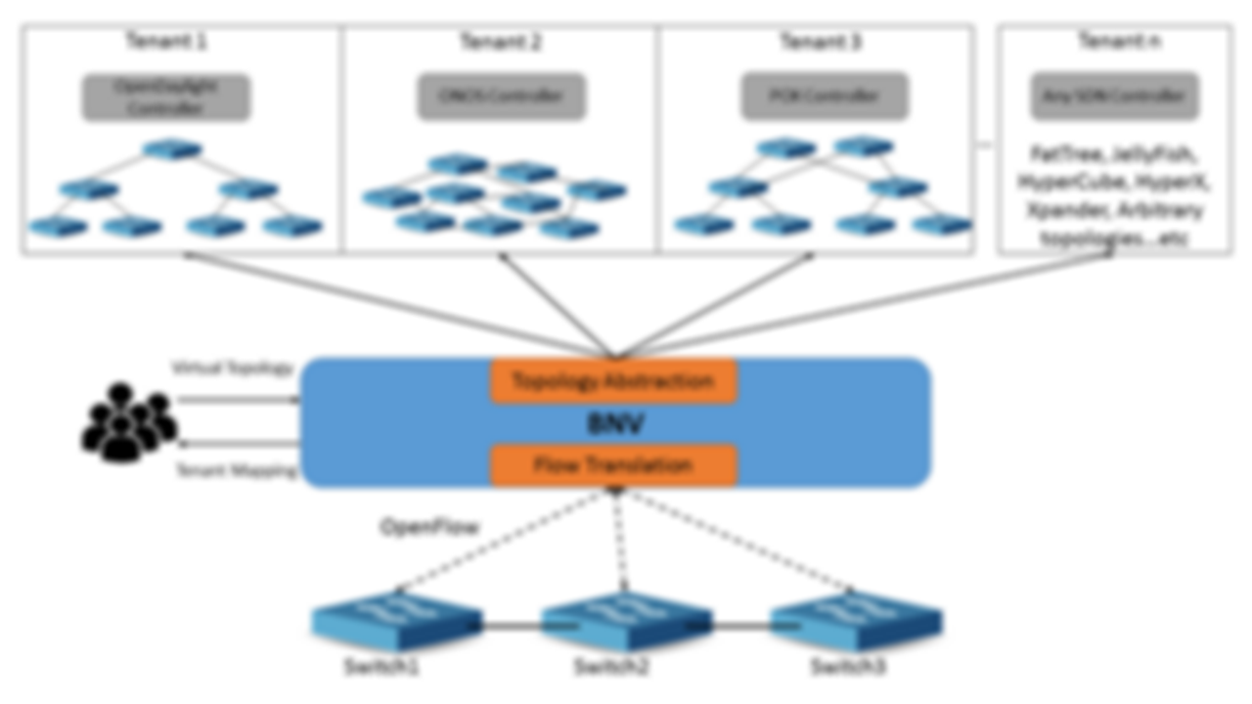
BNV Mapper

Slide 30
BNV Mapper (Virtual Network Embedder)
Request
1
1
BNV
Mapper
10
1
1
1
1
Mapping

Slide 31
BNV Mapper
A Virtual Topology Consists of :
A set of hosts V,
A set of (virtual) switches S,
A set of (virtual) links L
Core Link
Host Link
H1
H2
H3
H4
H5
H6
H7
H8

Slide 32
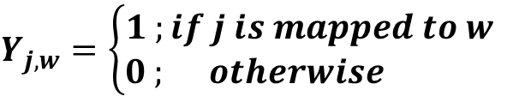
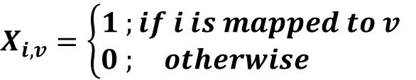
BNV Mapper
Solved using ILP
Variables :
$$X_{i,v}=\left\{\begin{aligned}1 ;if i is mapped to v \\ 0 ; otherwise \end{aligned}\right.$$
Core Link::
$$Y_{j,w}=\left\{\begin{aligned}1 ;if j is mapped to w \\ 0 ; otherwise \end{aligned}\right.$$
Host link:

Slide 33
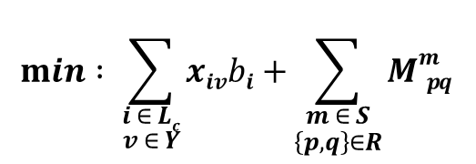
BNV Mapper
Objective is to Minimize the usage of Core-links:
a) Maximizes isolation to the tenant, keeping links dedicated.
b) Provides scope for dynamic expansions. (Adding/upgrading tenants)
$$min : \sum_{\begin{aligned}i ∈ Lc \\ v ∈ Y\end{aligned}}{xivbi+}\sum_{\begin{aligned}m ∈ S \\ \left\{p,q\right\}∈R\end{aligned}}{Mmp q }$$
Inter-Switch
Links
Big-Switch abstraction

Slide 34
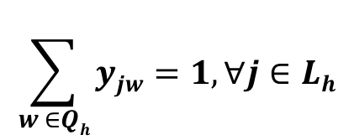
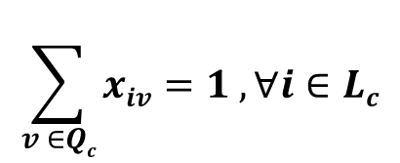
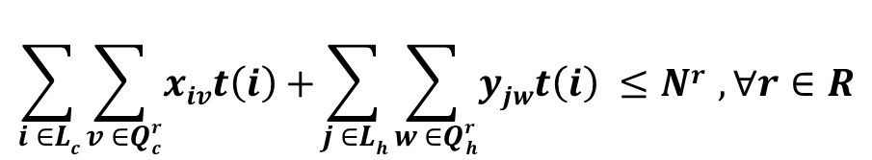
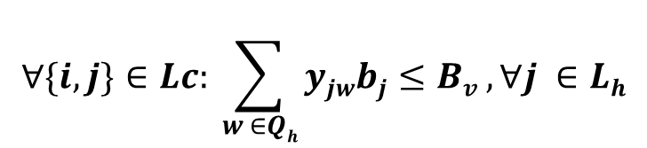
BNV Mapper - Constraints
$$\sum_{v ∈Qc}{xiv=1 ,∀i∈Lc}$$
1) Core Link one-to-one mapping:
$$\sum_{w ∈Qh}{yjw=1,∀j∈Lh}$$
2) Host Link one-to-one mapping:
$$∀\{i,j\}∈Lc: \sum_{w ∈Qh}{yjwbj≤Bv ,∀j ∈Lh}$$
3) Host Link Bandwidth constraint:
$$\sum_{i ∈Lc}{\sum_{v ∈Qrc}{xivt\left(i\right)+}}\sum_{j ∈Lh}{\sum_{w ∈Qrh}{yjwt\left(i\right) ≤Nr },∀r∈R}$$
4) TCAM capacity constraint

Slide 35
BNV Mapper – Big Switch Abstraction
H1
vSwitch1
H8
H2
H3
H4
H7
Virtual Topology
Physical Topology
Core Network
To | B/W
H4 | 1G
H7+H8 | 2G
To | B/W
H1+H2+H3 | 2G
H4 | 1G
To | B/W
* | 1G
CLink1
CLink2
CLink3
pSwitch1
pSwitch2
pSwitch3
1
2
3
1
2
3
1
2
3
H1
H2
H3
H4
H5
H6
H7
H8
H9

Slide 36
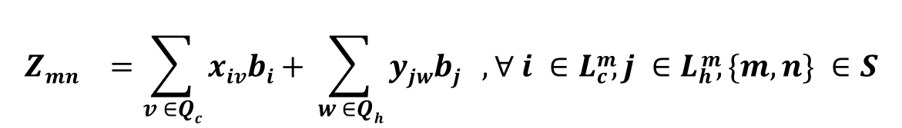
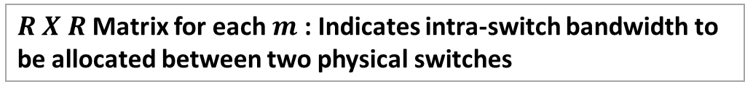
BNV Mapper - Constraints
5) One Big Switch Abstraction:
Total Bandwidth of $virtual switch m$mapped to n
$${Zmn}^{}=\sum_{v ∈Qc}{xivbi+ }\sum_{w ∈Qh}{yjwbj , ∀ i ∈Lcm, j ∈Lhm, \{m,n\} ∈S}$$
$R X R$Matrix for each $m$ : Indicates intra-switch bandwidth to be allocated between two physical switches
$${Mmpq}^{}=min \left(Zmp, Zmq\right), ∀m∈S, \{p,q\}∈R$$

Slide 37
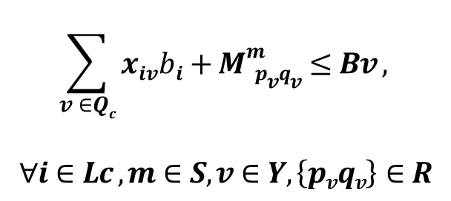
BNV Mapper - Constraints
6) Core Link Bandwidth constraint:
Inter-Switch
Links
Intra-Switch
fabric
Inter-Switch
Links
$$\sum_{v ∈Qc}{xivbi+}Mmp vqv≤Bv ,$$
$$∀i∈Lc ,m∈S,v∈Y,\left\{pvqv\right\}∈R$$

Slide 38
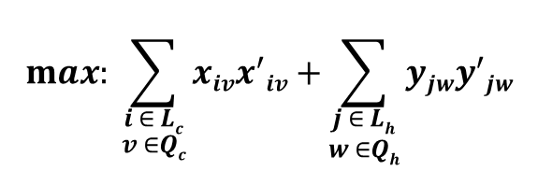
BNV Mapper – Topology Convertibility
Re-run the ILP with the modified objective
To maximize using the same switch-ports/links
$$max: \sum_{\begin{aligned}i ∈ Lc \\ v ∈Qc\end{aligned}}{xivx^{′}iv+}\sum_{\begin{aligned}j ∈ Lh \\ w ∈Qh\end{aligned}}{yjwy^{′}jw}$$

Slide 39



Implementation
Implemented on top of
Integrated with a Bare-metal provisioning service (Testbed).
Deployed on NCL Production Environment.

Slide 40
Implementation
Support OpenFlow 1.0/ 1.3
MAC address encodes <Tenant-id, Link-Id>
Rate-limiting using Switches’ classifier based QoS.

Slide 41
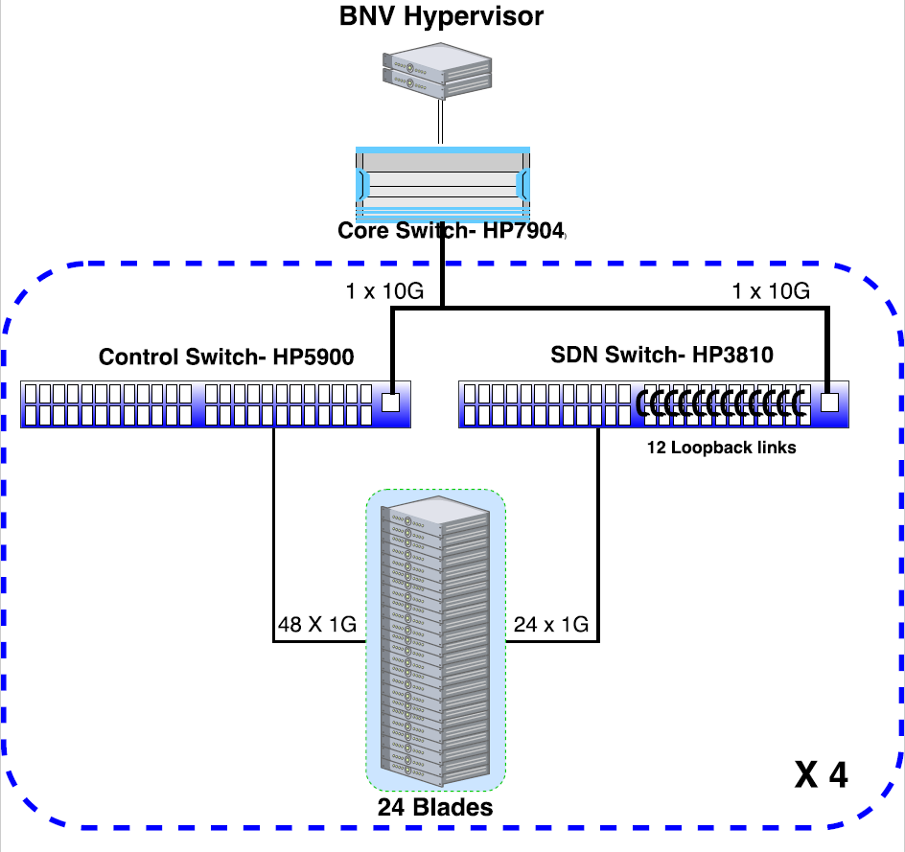
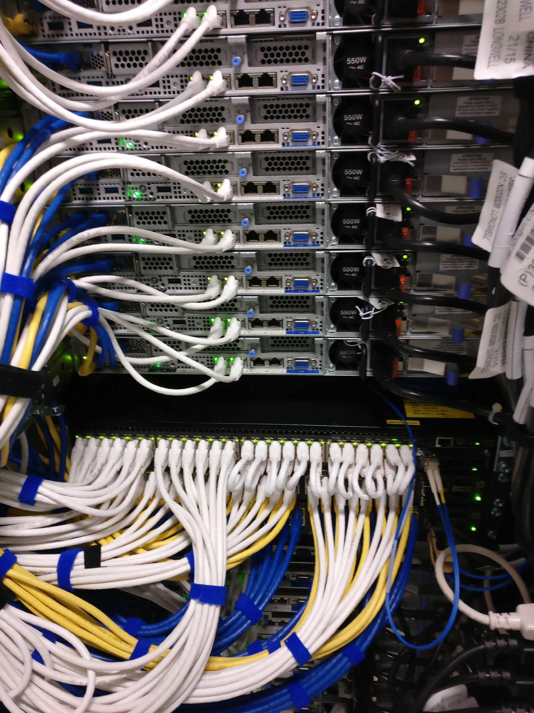
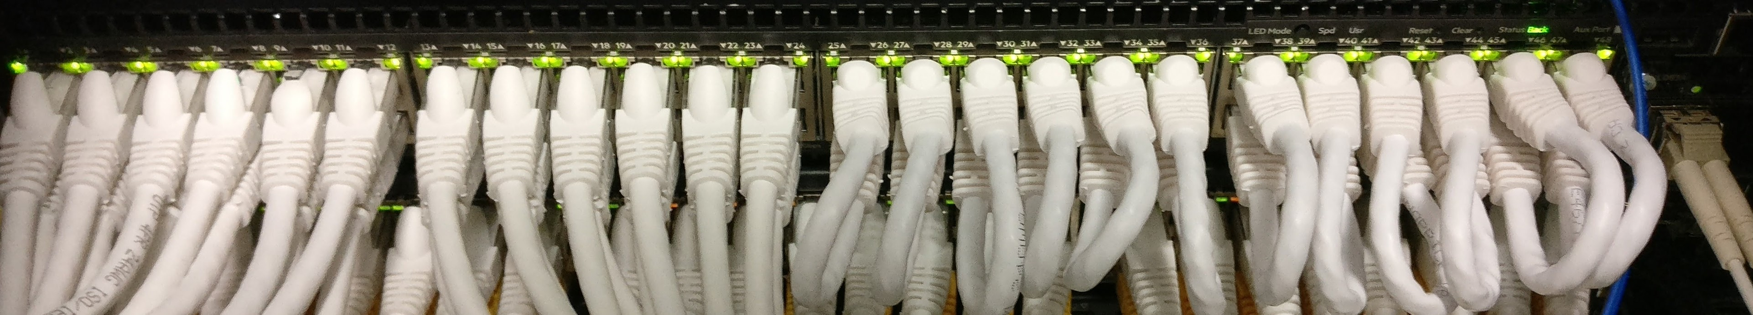
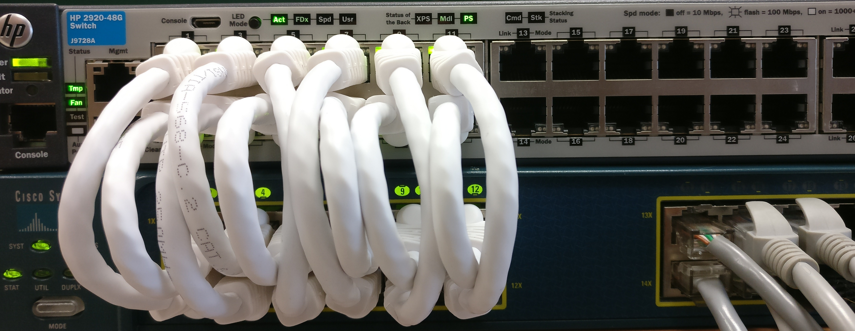
Implementation
Static loopback wiring
24-ports of SDN Switch
Dynamic Loopback Wiring
using L2 intermediate Switch

Slide 42
Evaluation
Can BNV faithfully replicate behaviour of topologies?
Provide control/data plane isolation to multiple tenants?
Embed complex topologies?

Slide 43
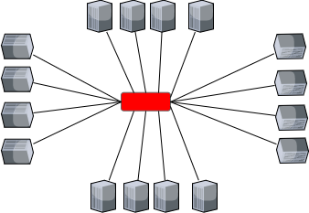
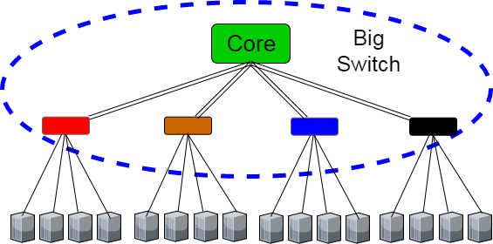
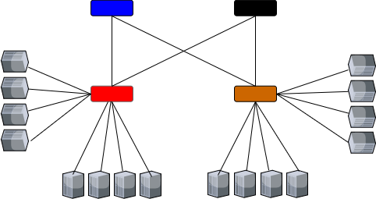
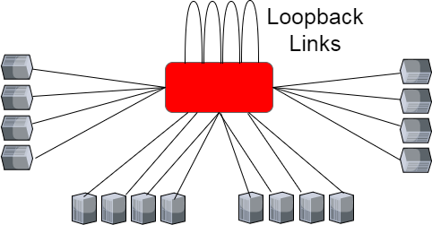
Evaluation : loopbacks & Big Switch Abstraction

Slide 44
Evaluation : loopbacks & Big Switch Abstraction

Slide 45
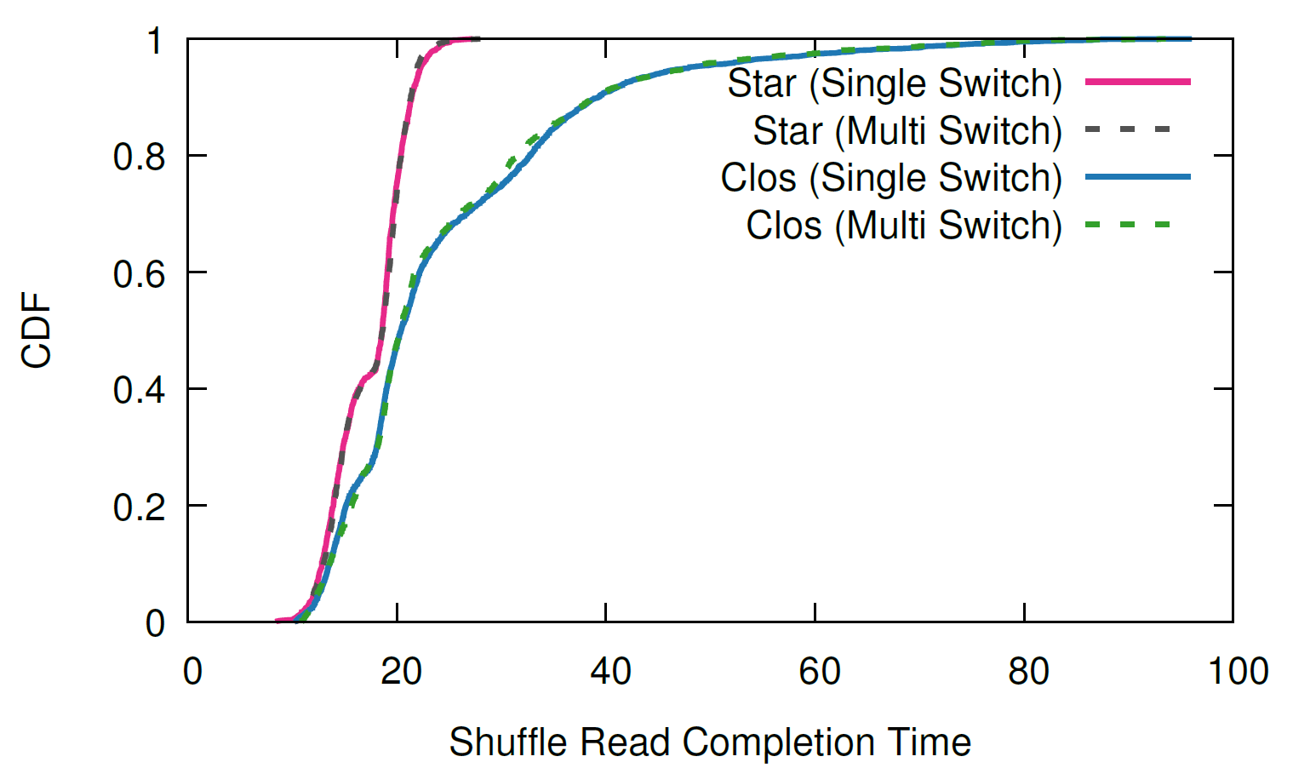
Evaluation : loopbacks & Big Switch Abstraction
Star (Single Switch)
Star (Multi Switch)
Clos (Single Switch)
Clos (Multi Switch)

Slide 46
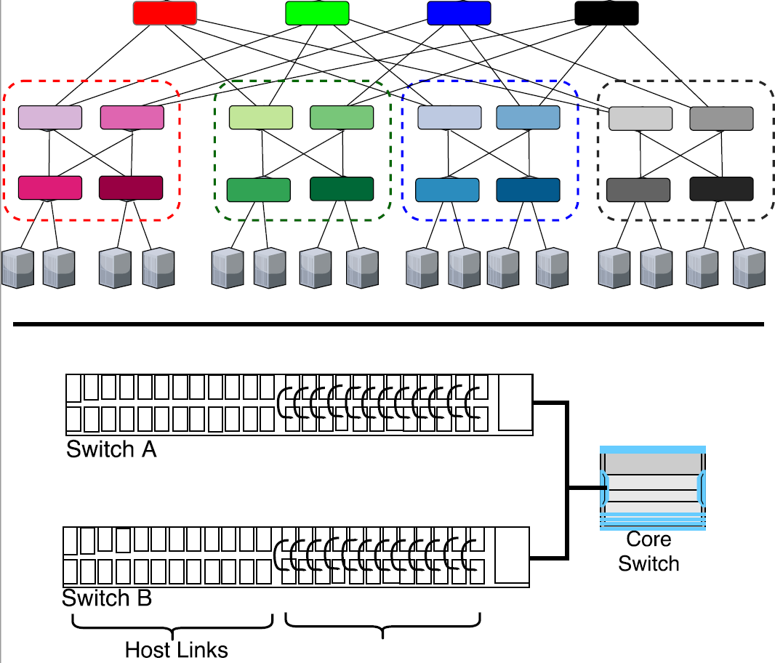
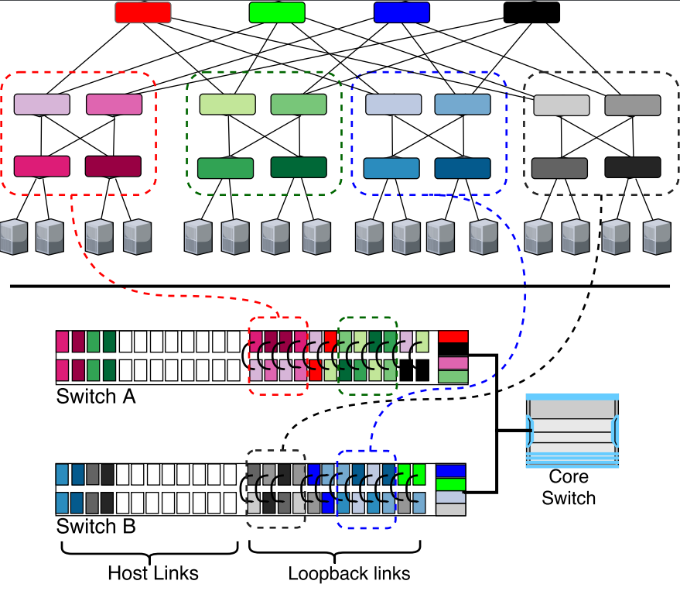
Evaluation : Mapping Complex Topologies

Slide 47
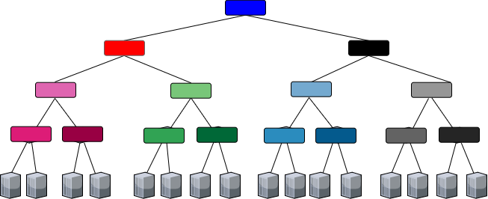
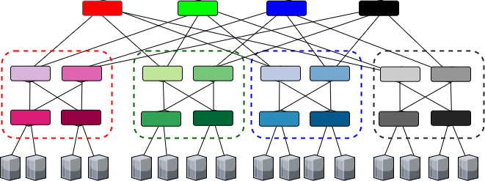
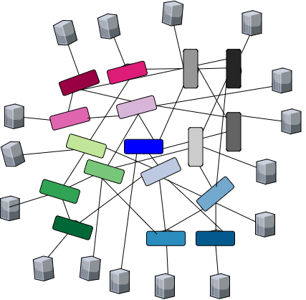
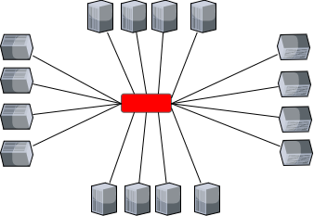
Evaluation : Fidelity of Complex Topologies
Single-Rooted Tree
Fat Tree
Jellyfish
Star

Slide 48
Evaluation : Fidelity of Complex Topologies
Single-Rooted Tree
Fat Tree
Fat Tree
Single-Rooted Tree
Fat Tree
Single-Rooted Tree
Fat Tree
Single-Rooted Tree
Fat Tree
Single-Rooted Tree
Fat Tree
Single-Rooted Tree
Fat Tree
Single-Rooted Tree
Fat Tree
Single-Rooted Tree
Fat Tree
Single-Rooted Tree
Fat Tree
Single-Rooted Tree
Fat Tree
Single-Rooted Tree
Fat Tree
Single-Rooted Tree
Single-Rooted Tree
Fat Tree
Jellyfish
Star
Jellyfish
Star
Jellyfish
Star
Jellyfish
Star
Jellyfish
Star
Jellyfish
Star
Jellyfish
Star
Jellyfish
Star
Jellyfish
Star
Jellyfish
Star
Jellyfish
Star
Jellyfish
Star
Jellyfish
Star

Slide 49
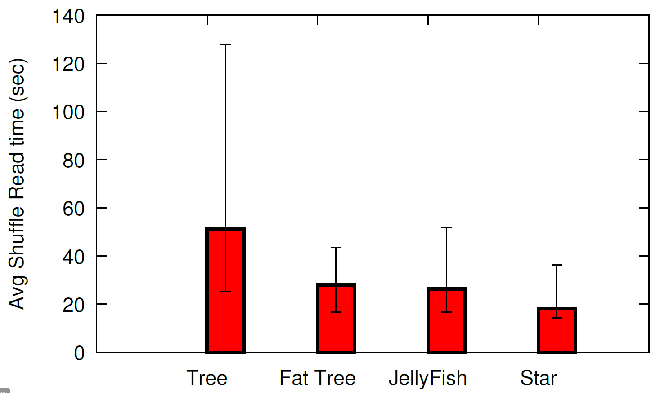
Evaluation : Fidelity of Complex Topologies
Single-Rooted Tree
Fat Tree
Jellyfish
Star

Slide 50
Evaluation : Fidelity of Complex Topologies
Single-Rooted Tree
Fat Tree
Jellyfish
Star

Slide 51
Evaluation : Fidelity of Complex Topologies
Fat Tree
Jellyfish

Slide 52
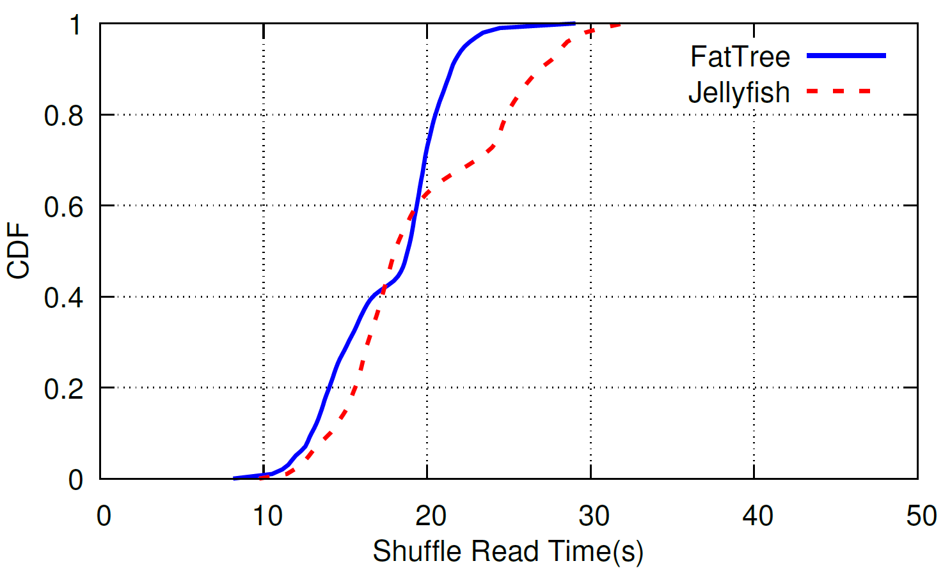
Evaluation : Fidelity of Complex Topologies
Fat Tree
Jellyfish

Slide 53
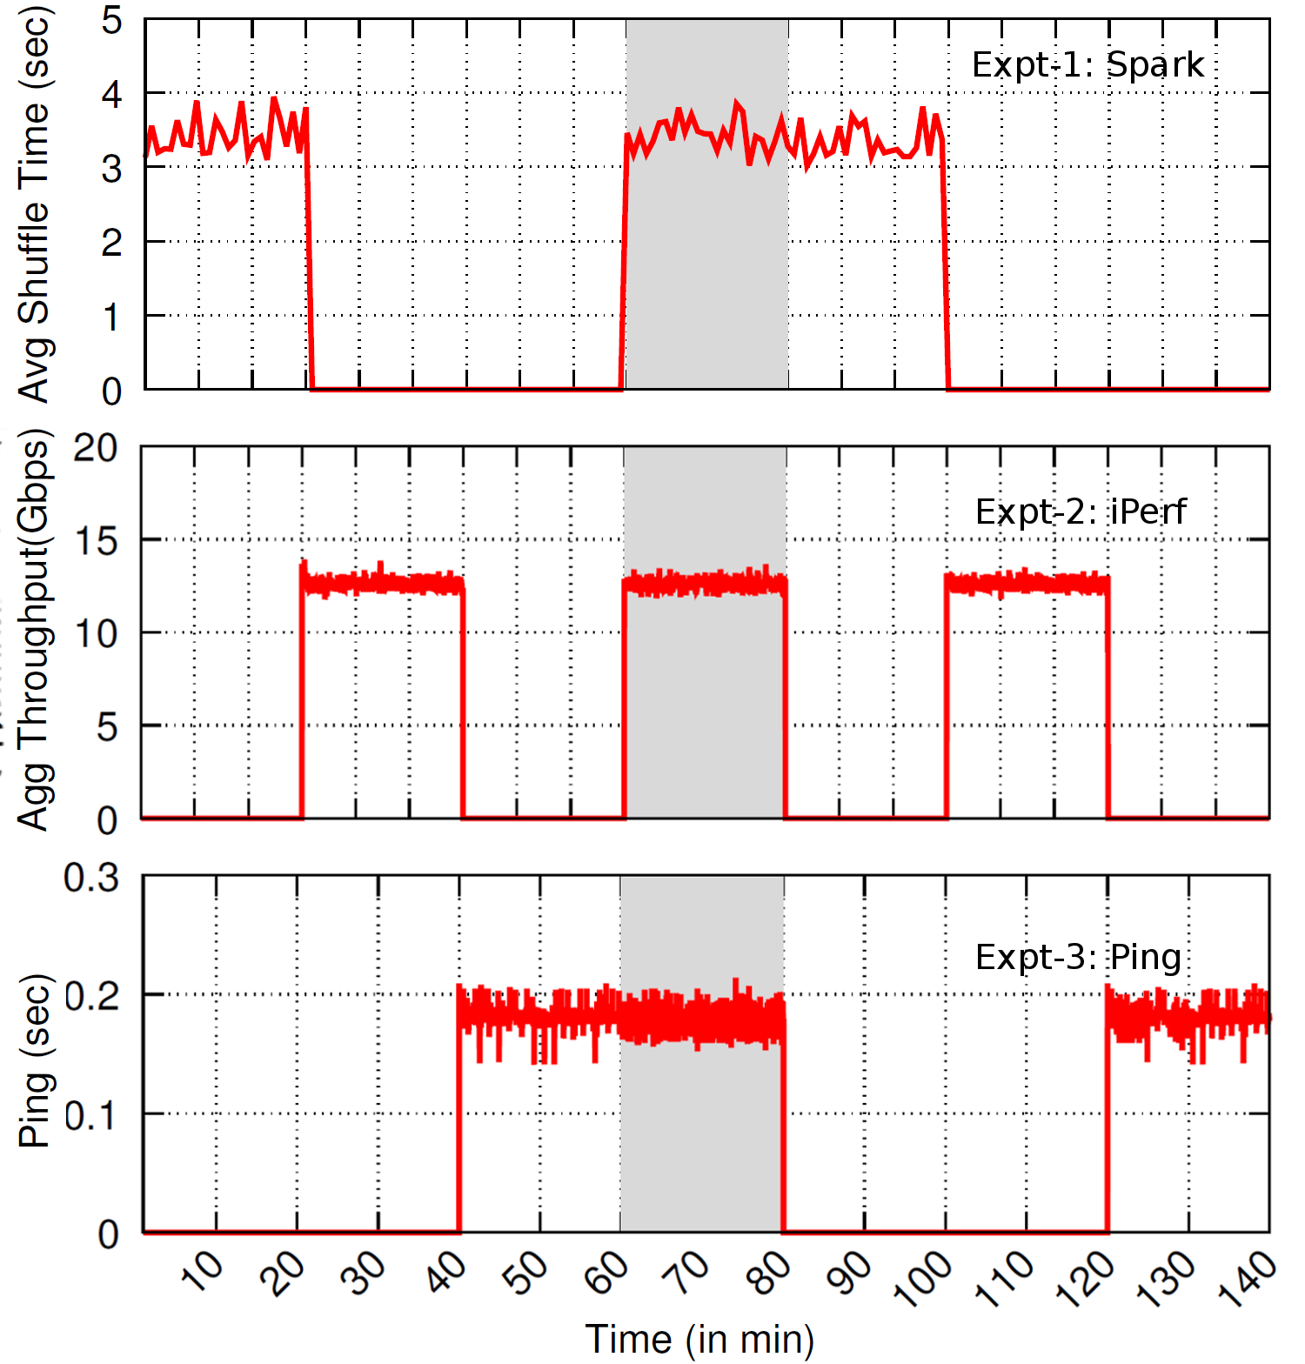
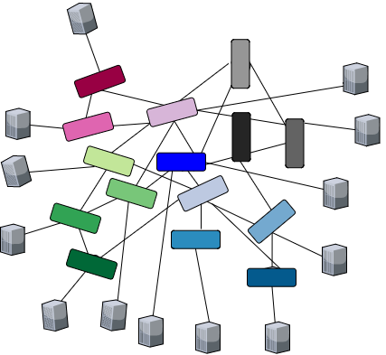
Evaluation : Isolation of multiple tenants
Fat Tree
Jellyfish
Random (Rest of the nodes)

Slide 54
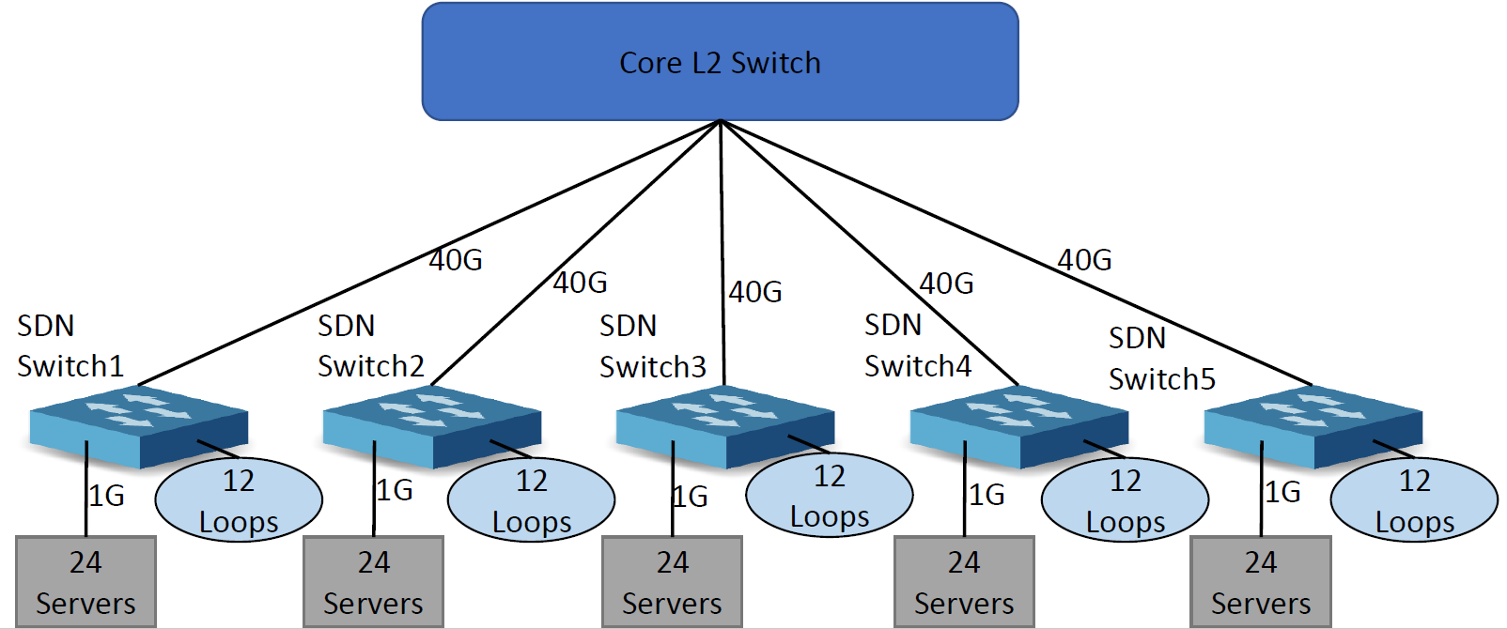
Evaluation : Scale of Topologies

Slide 55
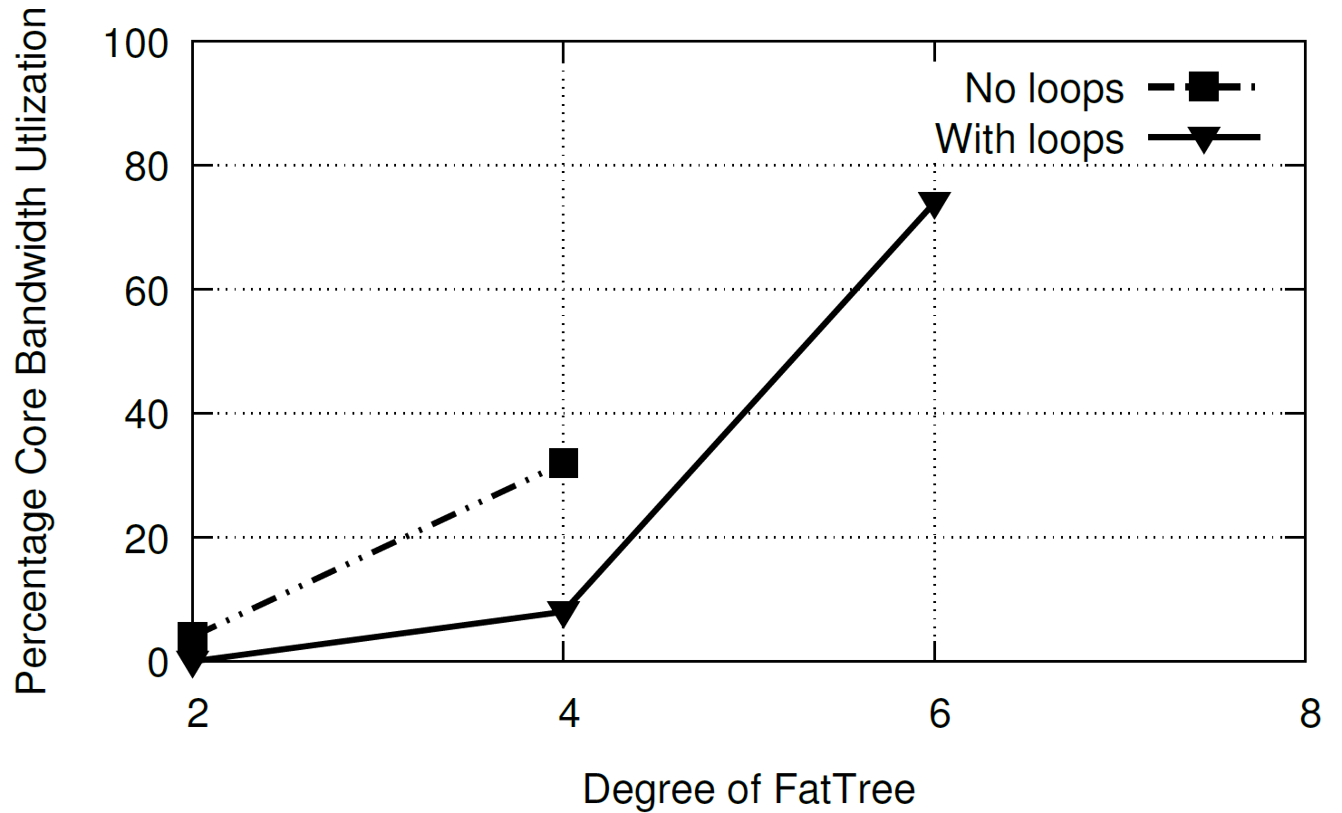
Evaluation : Scale of Topologies

Slide 56
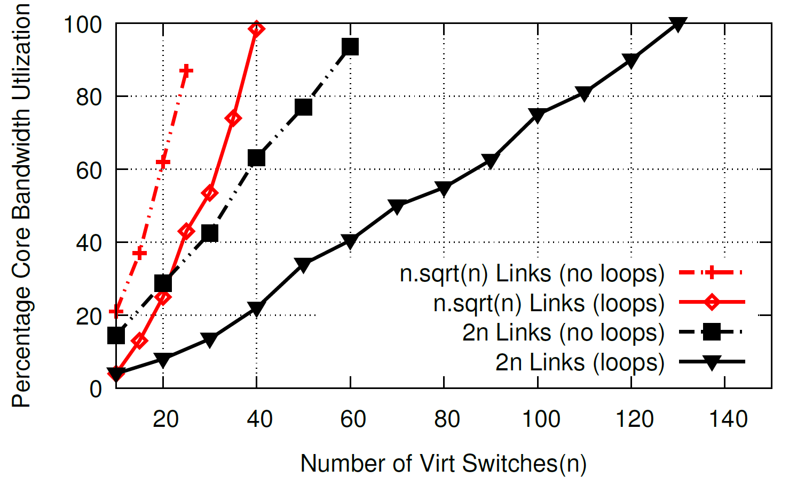
Evaluation : Scale of Topologies

Slide 57
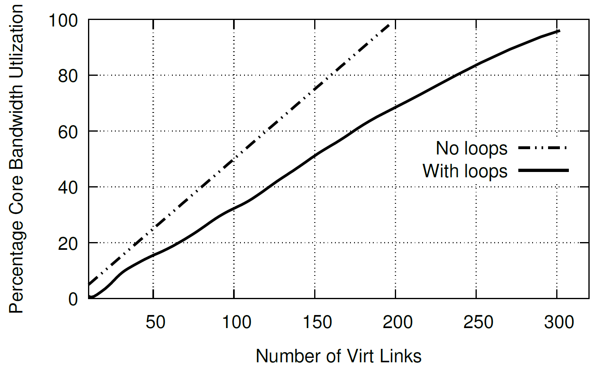
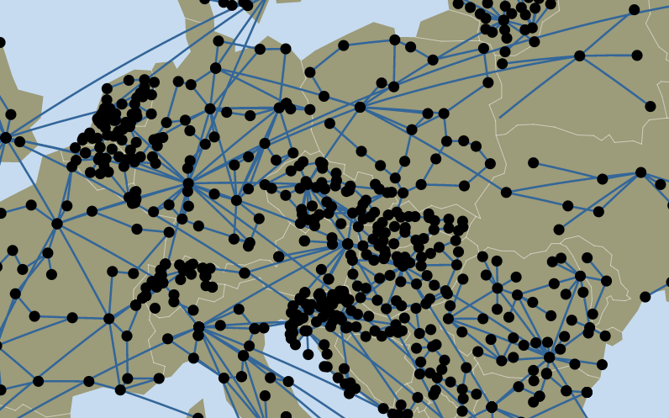
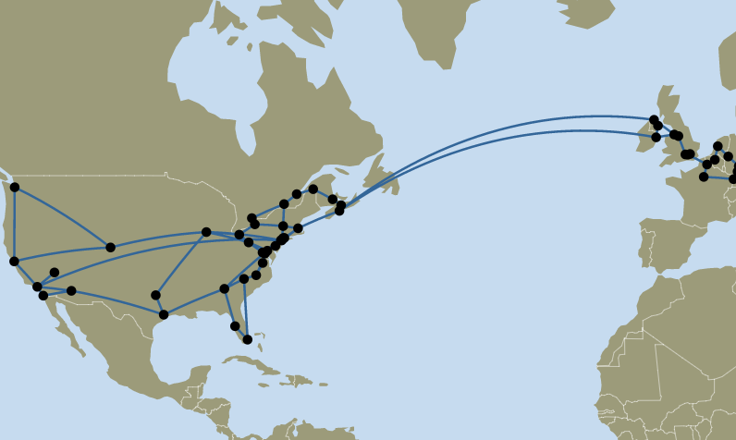
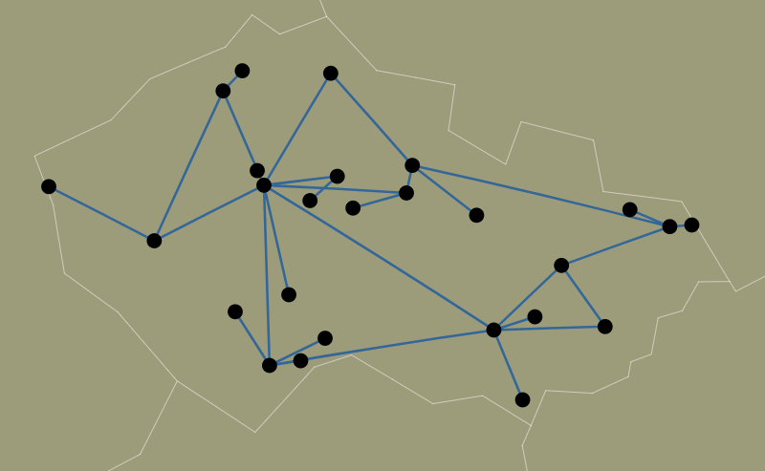
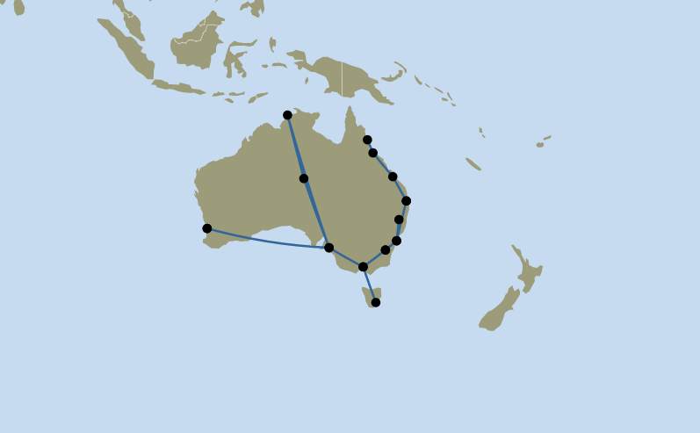
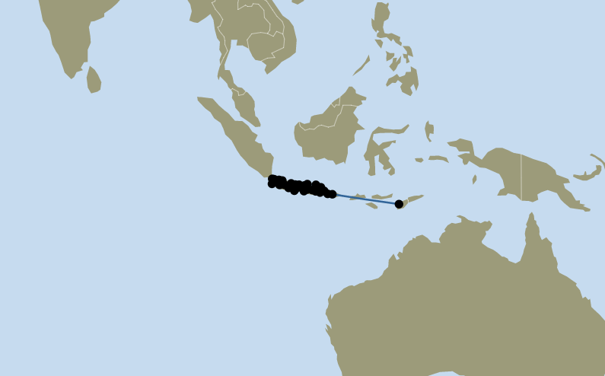
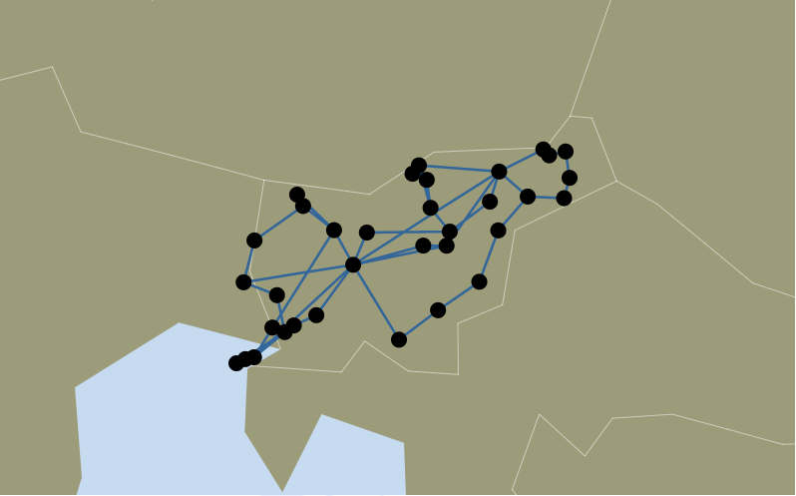
Evaluation : Scale of Topologies

Slide 58


